Slide 1
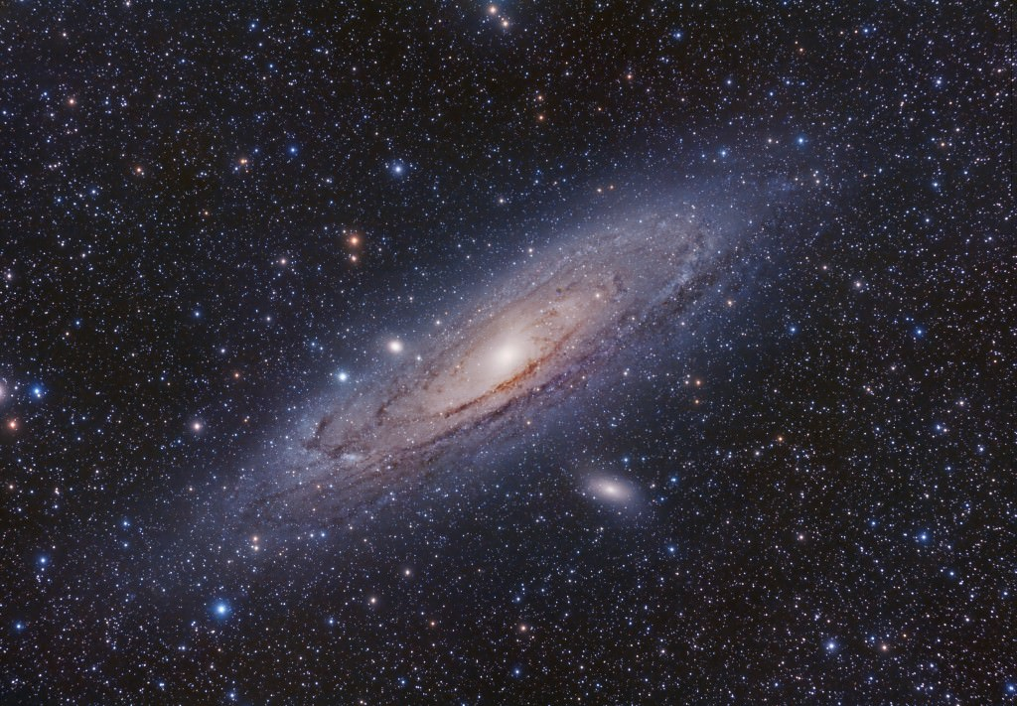


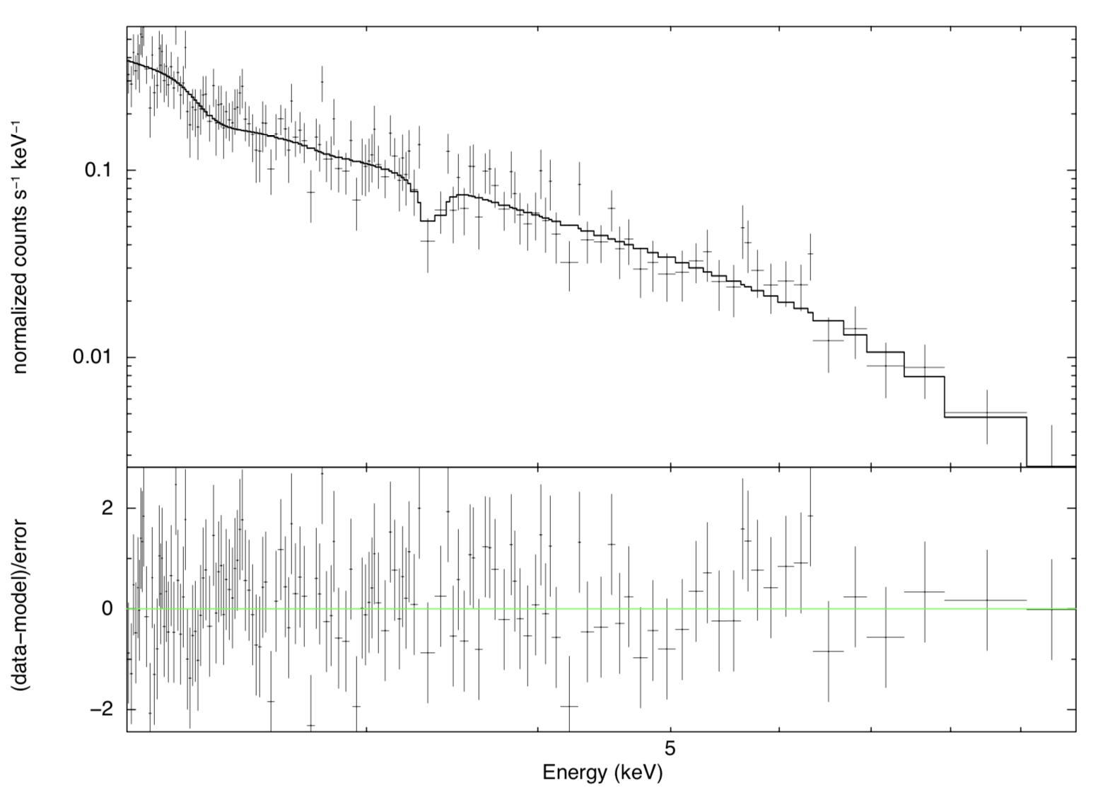
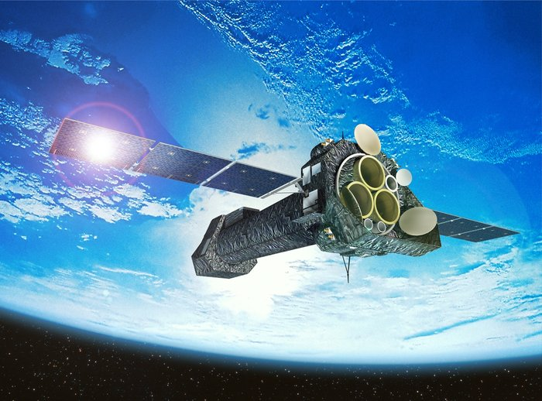
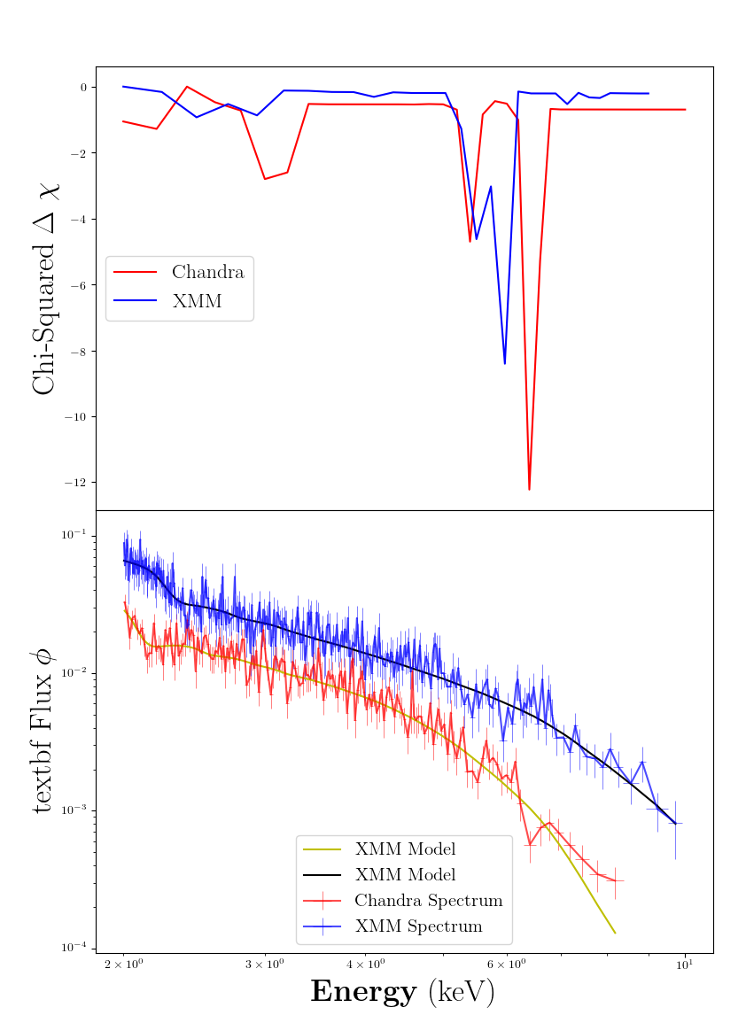
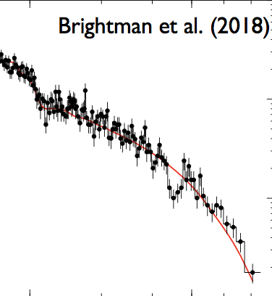








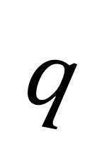


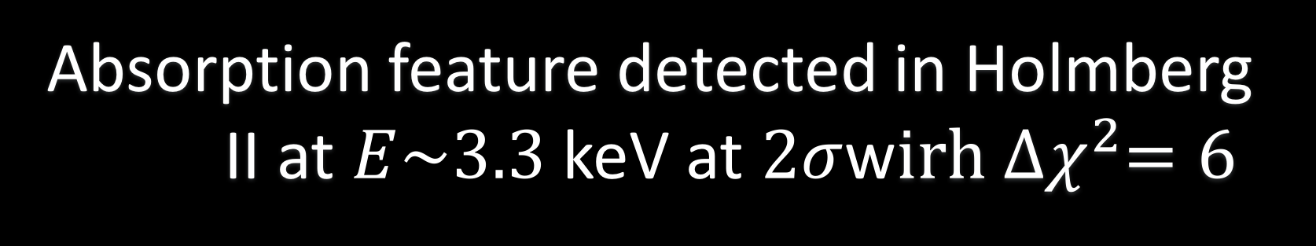
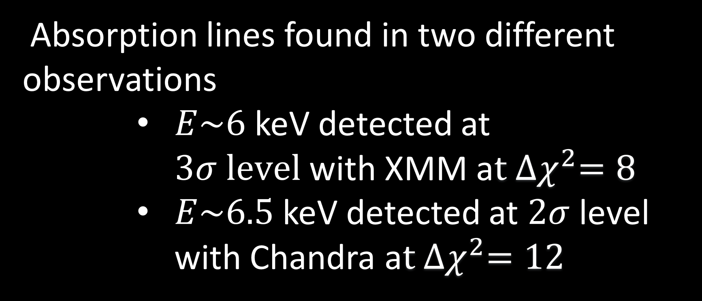

A systematic search for absorption features in the X-ray spectra of ultraluminous X-ray sources
A. Sosanya^{1,2}, M. Brightman¹, F.A Harrison¹, M. Heida¹, H.P Earnshaw¹, K. Madsen¹
California Institute of Technology, Pasadena, US
Dartmouth College, Hanover, NH
STAR POWER
(Left)
ULXs are powered by the accretion onto a black hole or neutron star feeding from a stellar companion onto an accretion disk.
Ultraluminous X-ray sources (ULXs) are variable, non-nuclear, bright X-ray sources in nearby galaxies independent of the central supermassive black hole. These ULXs have greater luminosities than the Eddington limit of stellar mass black holes or neutron star. These ULXs break Eddington theory because of extreme accretion rates onto a compact stellar remnant, or a black hole.
Some ULXs were recently discovered to be neutron-star powered. Unlike black holes, neutron stars have an intense magnetic field that allow super-Eddington accretion. Using the data from the XMM-Newton and Chandra X-ray observatories, we conducted a systematic search to find cyclotron resonance scattering features (CRSFs) to identify neutron-star powered ULXs. The results provide insight into the analysis techniques for future neutron star-powered ULXs and field strength estimates.
RESULTS
We found three strong absorption line candidates for analysis: Holmberg II, IC 342, and M32.
HOLMBERG II
EDDINGTON LUMINOSITY
Absorption feature detected in Holmberg II at $E\sim 3.3$ keV at $2σ$w$irh {∆χ}^{2}=6$
The Eddington Luminosity is the maximum luminosity a star attains when radiation pressure from the star and gravitation pressure are balanced.
(Left) XSPEC plot of Holmberg II spectrum, shjowing absorption feature at 3.3 keV.
NS
Holmberg II
XMM-Newton X-Ray Telescope
$\frac{dP}{dr}=\frac{kp}{c}F_{rad}$ = $\frac{GMp}{r^{2}}$, where $F=\frac{L}{4πr^{2}}$
$${ L}_{ed}=\frac{4πGc}{k}M$$
$${ G}_{NS}$$
$$F_{rad}$$
CRSFs
$$E_{2}$$
$$E_{3}$$
Induced cyclotron lines in spectra imply the presence of a magnetized neutron star and give a measurement of its field strength. A substantial magnetic field on around ${10}^{14}−{10}^{15} G$ would reduce radiation pressure and allow super-Eddington accretion.
$$q$$
$$E_{1}$$
$$B$$
$$E=0$$
IC-342
M32
$E\sim 5$ keV detected at $2σ level$in XMM observation with ${∆χ}^{2}=8$
(Above)
A 2-D representation of Landau levels
Although IC-342 showed statistical promise, there were no visible features detected within the continuum.
(Right) Cyclotron line found in M51’s ULX-8 found by M.Brightman, now believed to be neutron-star powered.
METHODS
M32
SYSTEMATIC SEARCH
The ULXs observed in M32 are proximate to each other, and therefore needed Chandra data for spatial resolution.
${∆χ}^{2}$Contour
Cross-referenced the Serendipitous XMM-Survey to find ULXs with at least 10,000 intensity counts.
Flux
SPECTRAL ANALYSIS
Absorption lines found in two different observations
$E\sim 6$ keV detected at $3σ level$with XMM a$t {∆χ}^{2}=8$
$E\sim 6.5$keV detected at $2σ$ level with Chandra a$t {∆χ}^{2}=12$
Reduced XMM/Chandra data and found favorable spectral extraction parameters using Chi Squared test.
Used spectral fitting software XSPEC to analyze detector data and fitted the spectra with a coupled cutoff power law continuum and Gaussian absorption (zgauss) to find CRSFs
Ran 10,000 simulations to assess false alarm rates.
(Right) Contour and flux plots of Chandra and XMM observations of M32
CONCLUSION
Different energies between XMM/Chandra M32 observation may be due to
the magnetic field orientation changing between observations.
possibility of an Iron outflow at one of the energies.
a statistical fluctuation in spectral data
contributions from the two proximate X-Ray sources are additive.
Holmberg II and M32 show the absorption-like features that may be either cyclotron lines or atomic. To consolidate our findings, spectral data needs to be compared across detectors. Future observations are needed to gather more data on these sources.
ACKNOWLEDGEMENTS
Caltech WAVE Fellows Program
SoCal Edison
REFERENCES
M. Brightman et al. 2018
H.P. Earnshaw et al. 2018
M. Bachetti et al. 2014
D.J Walton et al. 2016

